Slide 1
ASP.NET + Ajax

Slide 2
Ajax
Ajax (Asynchronous JavaScript and XML)
A group of interrelated web development techniques used for creating interactive web applications.
Increases responsiveness and interactivity of web pages achieved by exchanging small amounts of data with the server "behind the scenes" so that entire web pages do not have to be reloaded each time there is a need to fetch data from the server. This is intended to increase the web page's interactivity, speed, functionality and usability.

Slide 3
Ajax
Ajax is asynchronous, in that extra data is requested from the server and loaded in the background without interfering with the display and behavior of the existing page.
JavaScript is the scripting language in which Ajax function calls are usually made
Data is retrieved using the XMLHttpRequest object that is available to scripting languages run in modern browsers (alternatively, use of Remote Scripting (Java Applet))

Slide 4
AJAX
An acronym that stands for Asynchronous Javascript and XML
A technology that supports updating a page with small amounts of information without a postback
Makes the page appear to be responsive to user inputs.

Slide 5
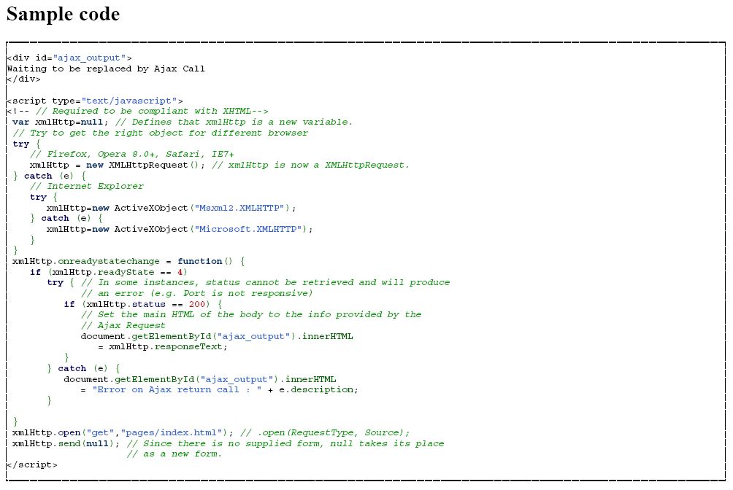
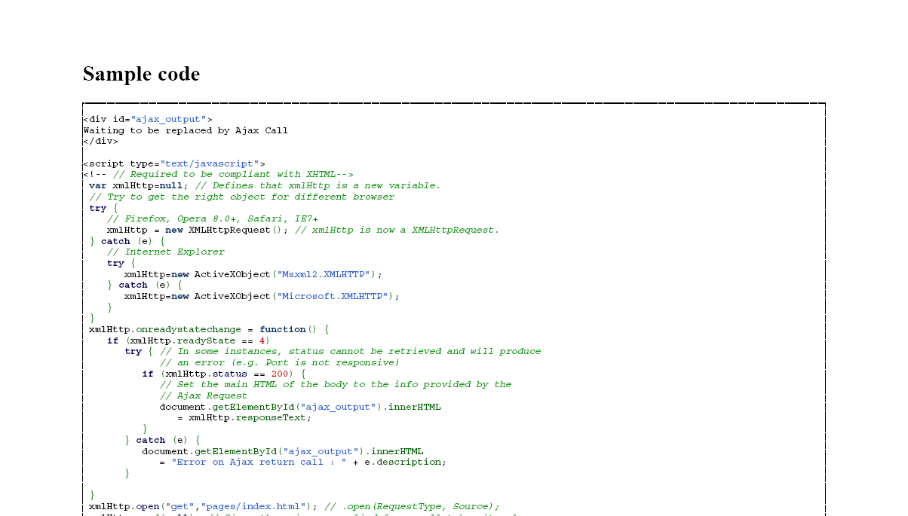

Slide 6
Ajax
XML is sometimes used as the format for transferring data between the server and client, although any format will work, including preformatted HTML, plain text and JSON. (These files may be created dynamically by some form of server-side scripting.
It is not required that the asynchronous content be formatted in XML

Slide 7
ASP.NET AJAX
Is an extension to ASP.NET (From .NET 3.5 included in the Framework and partly in VS2008)
Consist of
    ASP.NET 2.0 AJAX Extensions (Server side Core)
    Microsoft Ajax Library (Client Side)
    ASP.NET AJAX Control Toolkit with ASP.NET Controls ”combining” (server and client side, add on from community).
Supports modern browsers such as Internet Explorer, Firefox, and Safari
Mobile devices such as Windows Mobile are currently not supported

Slide 8
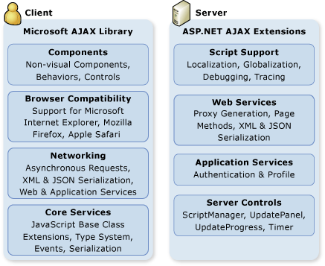
ASP.NET’ group of interrelated web development techniques

Slide 9
ASP.NET AJAX Server Controls
The ASP.NET AJAX server controls consist of server and client code that integrate to produce AJAX-like behavior. The following list describes the most frequently used ASP.NET AJAX server controls. (Default in VS2008)
ScriptManager
  Manages script resources for client components, partial-page rendering, localization, globalization, and custom user scripts. The ScriptManager control is required in order to use the UpdatePanel, UpdateProgress, and Timer controls.
UpdatePanel
  Enables you to refresh selected parts of the page, instead of refreshing the whole page by using a synchronous postback.
UpdateProgress
  Provides status information about partial-page updates in UpdatePanel controls.
Timer
  Performs postbacks at defined intervals. You can use the Timer control to post the whole page, or use it together with the UpdatePanel control to perform partial-page updates at a defined interval. (The “pull updater”)

Slide 10
What is Asp.Net Ajax?
A largely Javascript library that supports Ajax.
.Net Ajax provides:
  An XML-based declarative markup
  Ajax Javascript library that provides client-side functionality
  A webservice bridge that supports client use of web services, via a Javascript proxy
  You can expose methods on the aspx page as web services that your client can then consume
    This extends the event-based model by adding non-event invocations, e.g., no postback and more flexible invokes
  Update panels, defined server-side that enable the Ajax asynchronous communication with the server
  Supports a client-side databinding model, again, via Ajax
    Data is still coming from server, but control is populated with Ajax

Slide 11
ASP.NET AJAX Client Architecture
The ASP.NET AJAX client-script libraries consist of JavaScript (.js) files that provide features for object-oriented development. The object-oriented features included in the ASP.NET AJAX client-script libraries enable a high level of consistency and modularity in client scripting. The following layers are included in the ASP.NET AJAX script libraries:
A browser compatibility layer. This provides compatibility across the most frequently used browsers (including Microsoft Internet Explorer, Mozilla Firefox, and Apple Safari) for your ASP.NET AJAX scripts.
ASP.NET AJAX core services, which include extensions to JavaScript, such as classes, namespaces, event handling, inheritance, data types, and object serialization.
An ASP.NET AJAX base class library, which includes components such as string builders and extended error handling.

Slide 12
ASP.NET AJAX Client Architecture
A networking layer that handles communication with Web-based services and applications, and that manages asynchronous remote method calls.
Support for JavaScript libraries that are either embedded in an assembly or are provided as standalone JavaScript (.js) files. Embedding JavaScript libraries in an assembly can make it easier to deploy applications and can solve versioning issues.
Support for accessing server-based forms authentication and profile information in client script. This support is also available to Web applications that are not created by using ASP.NET, as long as the application has access to the Microsoft AJAX Library.
Support for release and debug modes and localization support for both assembly-embedded and standalone JavaScript files. For more information

Slide 13
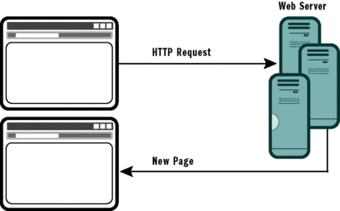
Standard Model
Traditional Full-Page Postback Operation

Slide 14
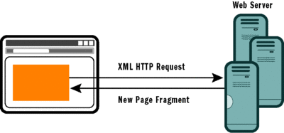
Partial Rendering Model
AJAX XMLHttpRequest Partial Rendering
Partial rendering is limited to one request operation at a time in order to preserve the consistency of the view state—which remains an integral part of the model. And this goes against the first A in AJAX: asynchronous.

Slide 15
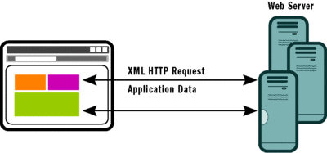
SPI Model
Single-Page Interface Elements within a Page
In the SPI model, the main page is a combination of visual elements that can be loaded, updated, and replaced independently (The A is back again)

